Slide 1
PROTOTYPING
Three Options:
PMOS
CMOS Inverter
Solid State Relay

Slide 2
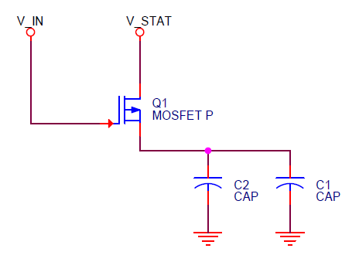
OPTION 1 – PMOS
ON STATE :
V_{IN} < V_{STAT} – V_{TH} ✔
OFF STATE :
V_{IN} > V_{STAT} – V_{TH} ✖
Unsuccessful.

Slide 3
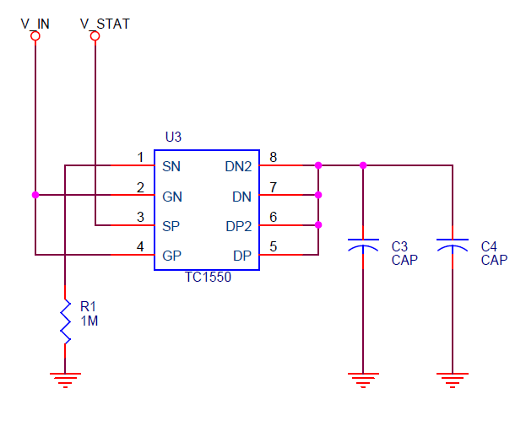
OPTION 2 – CMOS
ON STATE :
V_{IN} < V_{STAT} – V_{TH} ✔
OFF STATE :
V_{IN} > V_{STAT} – V_{TH} ✖
Unsuccessful.

Slide 4
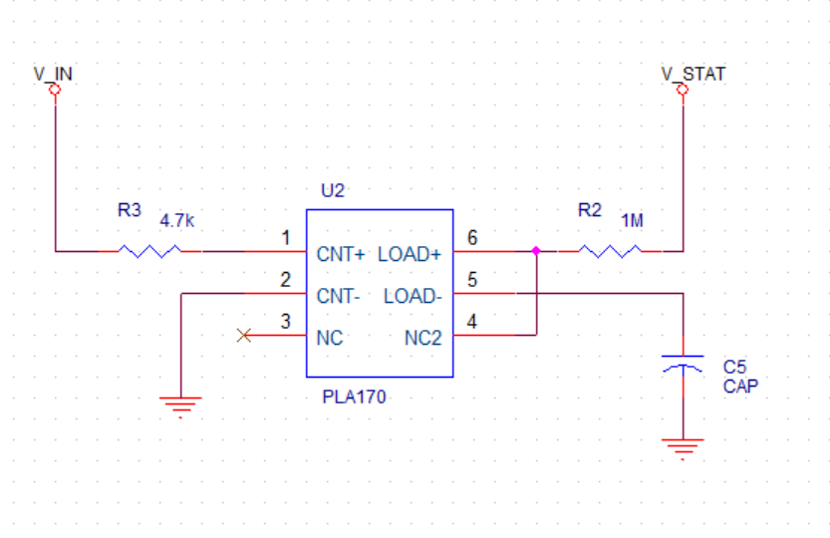
OPTION 3 – SSR
ON STATE :
V_{IN} < V_{STAT} – V_{TH} ✔
OFF STATE :
V_{IN} > V_{STAT} – V_{TH} ✔
Successful.

Slide 5
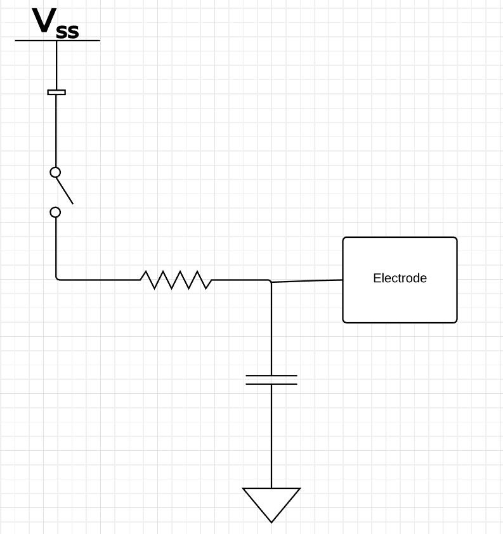
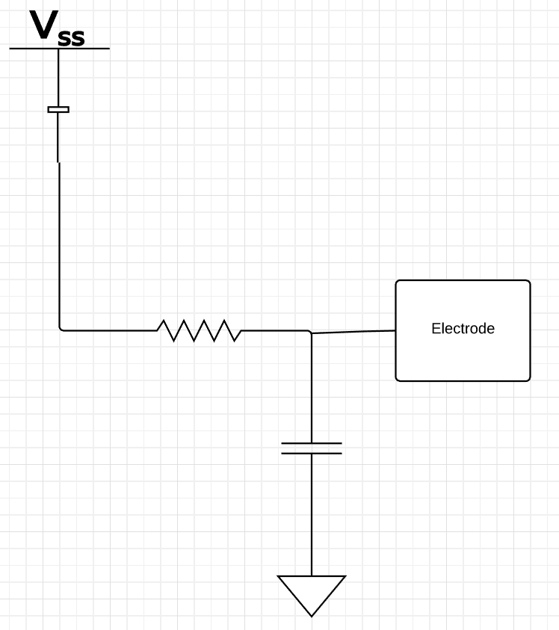
PCB DESIGN
We are not expecting static power dissipation
With this scheme, we can experiment with a refresh rate AND measure power dissipation for a parallel On/Off scheme
Circuit
Off State
On State

Slide 6
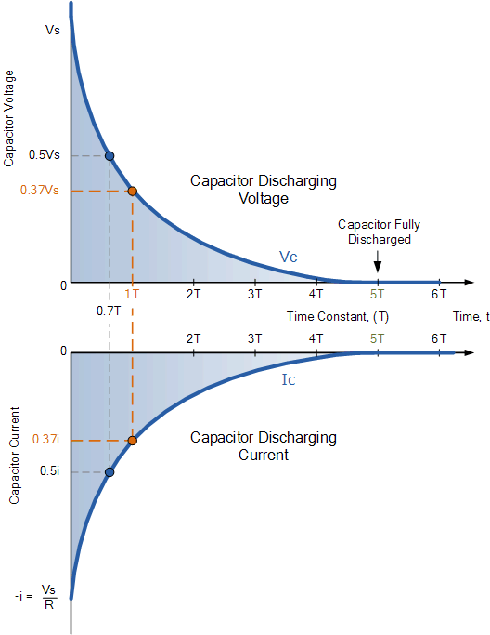
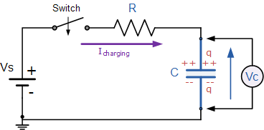
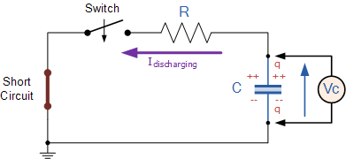
CHALLENGES
High inrush current
Leakage as discharge path

